Slide 1
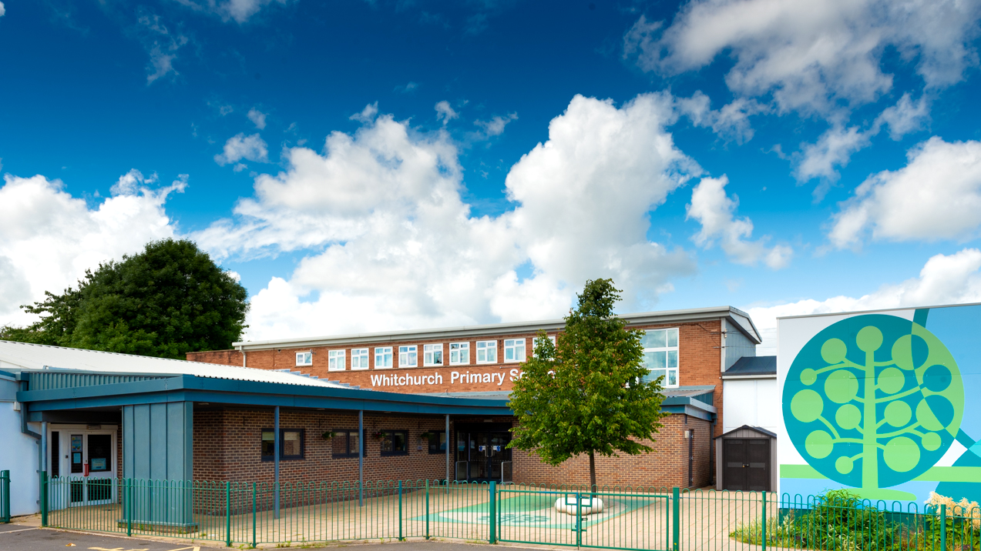

Whitchurch Primary School: Welcome to Year 1
Photo of school

Slide 2
Our Vision and Values

Slide 3



Slide 4


Slide 5
Parent Meetings
November 2026 - Parent Consultations (Online)
February 2027 - Parent Consultations (Face to face)
July 2027 - Curriculum Celebration event

Slide 6
Attendance and Punctuality

Slide 7
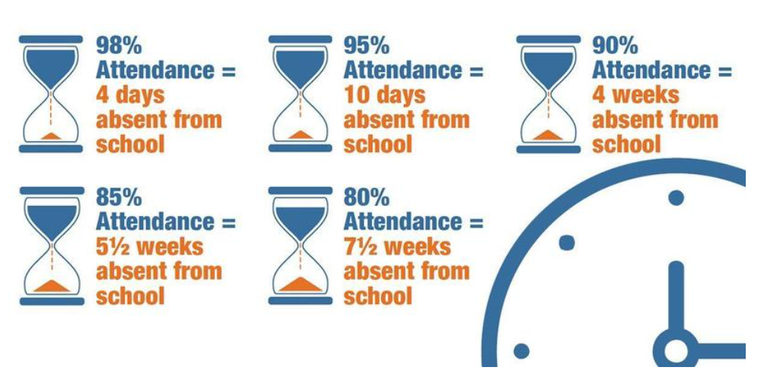
Reading
Attendance
Attendance Target: 96% Currently: 95%

Slide 8
Punctuality
Teaching at Whitchurch Primary School starts at 8.55am.
Please make every effort to ensure that your child arrives on time, to minimise disruption for the pupil, the rest of the class and the teacher: late arrivals may miss the important teaching points at the start of the lesson.
Minutes late | Days lost in school
5 minutes | 3 days
10 minutes | 6.5 days
15 minutes | 10 days
20 minutes | 13 days
30 minutes | 19 days
Any child who arrives after 8.55am, including those using the Foundation Phase entrance, will need to be signed in electronically at the main Reception office.

Slide 9

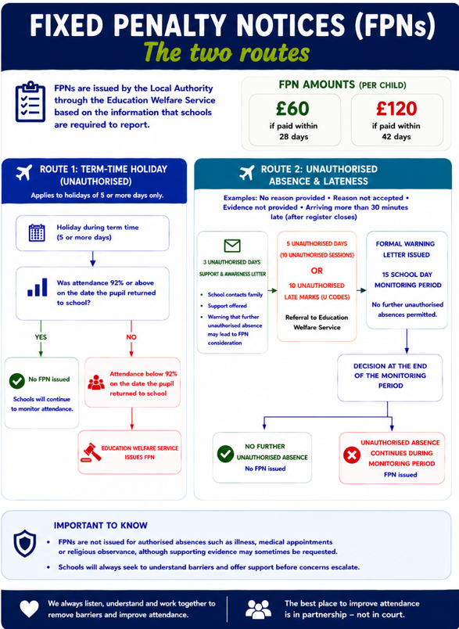
Attendance

Slide 10
Reading

Slide 11

Reading Books
We will be reading with your child in school and assessing their current reading levels. We will be sending books home for them to practice their skills with you and develop a love of reading.
We will send information / words to practise at home and we appreciate your support in practising these regularly at home.
Reading books will be changed on a Thursday or Friday, but please send your child with their book bag everyday.

Slide 12
Power of Reading
Children that read 20 minutes every day or more can learn upward of two million words annually.
Regular reading has been shown to lower stress levels by as much as 68%.
80% of children have increases in specific areas of the brain when they’re read to daily.
Children that read for five minutes every day take in 282,000 new words every year.

Slide 13
Day in the life of Year 1

Slide 14
A day in Year 1
Self registration and Wellbeing wall
Morning activities - A carousel of funky fingers, reading, phonics and maths games that the children access independently.
Letters and Sounds Phonics sessions
Literacy/Maths Focussed Tasks as well as Ditectif Dysgu tasks to develop own learning.
Welsh Dyddiol Deg (Welsh Oracy)
Lunchtime (11.45-12.45)
Maths Fluency Tasks in groups
Inquiry Sessions
Assembly

Slide 15
Useful Information about Year 1

Slide 16

Drinks Bottles and Snacks
We are a Healthy School and promote the children having continuous access to clean water.
Please ensure your child brings in a labelled drinks bottle daily. This is in addition to any water bottles you wish to provide for lunchtime. The children will have continual access to drinking water throughout the day.
Notes:
SL

Slide 17


Snack Time
Snack is available throughout the morning and pupils are encouraged to independently choose when to eat their snack / drink.
As a school we support small businesses and provide your child with a healthy snack each day from the local green grocers.
We would appreciate a contribution of £1 per week to cover the cost of this. This can be paid via the parent pay app for each half term. Please see the office if you need your payment information.

Slide 18

P.E.
Your child’s P.E. days are as follows:
1KH (Miss Humphries) - Wednesday
1BC (Mrs Brown/Miss Collier) - Wednesday
1CZ (Mrs Zirker) - Tuesday
Please send your child to school wearing their PE kit (black leggings, joggers, shorts; white t-shirt and trainers) on class their PE day. They can wear their school uniform jumpers/cardigans on top as normal.
Pupils will need to bring their PE kit to change into if attending after school sports clubs.

Slide 19
Extra Help
Free School Meals; additional funding. If you receive the following, your family can apply for Free School Meals funding:
Income Related Employment Support Allowance
Income Support
Income Based Jobseeker's Allowance
Guarantee Element of State Pension Credit
Child Tax Credit with an income less than £16,190 or
Universal Credit if the net household earnings is less than £7400.

Slide 20
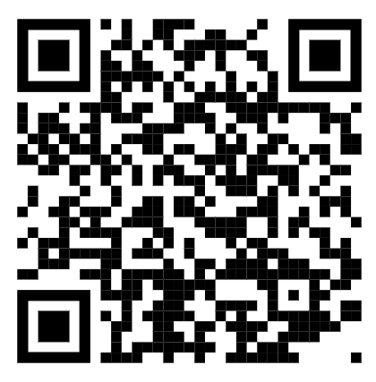
Why apply?
The school will get a small amount of funding per child- this can be used to support the children with resources in school, additional adult help if needed and contributions and payment of after school clubs, music lessons, trips and residential trips. This will ensure that all our pupils get the best possible experiences at Whitchurch.
To apply visit this link on Cardiff Council’s website:
https://www.cardiffcouncilforms.co.uk/article/1684/

Slide 21
Allergies
Should your child have any food allergies and receive a school meal:
Parents/carers must consult with their health professional in regard to their child’s specific dietary need.
Parents/carers or their chosen health professional should contact Education Catering at educationcatering@cardiff.gov.uk to outline the specific dietary requirement.
A member of the Education Catering Operations Team will liaise with the prates/carers/health professional to develop where possible a menu and environment that addresses the pupil’s specific dietary needs.
The agreed menu will then be implemented in school
Please note that when considering the safe provision of a meal to a child with a severe allergy Cardiff Education Catering will follow the recommendation of the health professional. Additionally, they are unable to provide a therapeutic diet to pupils of primary school age without the guidance of a health professional. Where a pupil has a complex need, Cardiff Education Catering are happy to work with parents/carers, schools and pupils to develop a school meal solution.
Education Catering operates and maintains an allergen matrix, which lists all the 14 allergens listed under retained EU regulation 1169/2011 Food Information to Consumers that appear or may appear in dishes on their menu. This matrix is available upon request.

Slide 22
PTA
The PTA help organise events and activities for the children which raise money for the school.
Activities include: Colour Run, Discos, Fetes, Easter bonnets, Halloween pumpkin competitions.
However, we only have a small team of 5 people and would love more help so we can organise a better and bigger range of family events. Please let us know if you would be interested in joining the PTA.
Thank you in advance!

Slide 23
Home Communication

Slide 24

Homelinks
General school information can be found on the website.
https://whitchurchprm.web11.juniperwebsites.co.uk/
Weekly updates will be sent initially through Parentmail but we will moving to Arbor in the near future.
Celebrations and achievements will be visible on Facebook.
The children will be bringing home letters containing details of how to access our online learning programme- Numbots.

Slide 25

Arbor Parent App
We are launching the Parent App for Arbor. This will give all parents access to key information such as; attendance, your child’s contact details and allergy and medical information. Consent for trips and photographs will also be able to be accessed.
Please check this is accurate when it is launched and amend as necessary if incorrect. Please also speak to teachers if there are any medical and allergy changes.
Moving forward all messages and emails are going to be through the app once fully launched.

Slide 26
Curriculum

Slide 27
Example Yearly Overview
Autumn Term
Spring Term
Summer Term
Language, Literacy and Communication
Mathematics and Numeracy
Health and Wellbeing
Humanities
Expressive Arts
Science and Technology

Slide 28
Literacy, Language & Communication:
Fact files
Posters
Letter
Asking questions
Welsh: language patterns… Dw i’n hoffi… Dw i’n byw…
Key concepts:
Belonging, community, place, change, Chronology, Viewpoints
Numeracy:
Place value
Addition & Subtraction
Money
Position and Turns
Year 1 Autumn Term: Changing Places
Expressive Arts:
Welsh Artists - Looking at landscapes from the local area
Humanities:
Where and how we live keeps changing.
Where do we live?
How has Whitchurch changed?
How schools, shops, special places have changed.
Toys now and in the past.
Science & Technology:
Push and Pull forces linked to toys
Design and make a moving paper toy.
Health & Wellbeing:
PE- coordination & balance/Gymnastics
Jigsaw e.g. belonging, me and my world
Other Experiences: Trip to St Fagans Museum
Visits from: Grandparents to talk about how school, toys and Whitchurch has changed.
Christmas Concert

Slide 29
Literacy, Language & Communication:
Book reviews
Retelling familiar stories
Story writing including Welsh Legends
Newspaper
Welsh: language patterns… Colours (Lliwiau) Shapes (Siap) Number (Rhifau)
Key concepts:
Art: Line, Colour, Pattern
Drama: Creating, Performing
Numeracy:
Place Value
Shape
Grouping and sharing (multiplication and division)
Fractions
Year 1 Spring Term: Show & Tell
Humanities:
Traditional Tales
Stories from the past
Expressive Arts:
Drama skills and Workshops
Storytelling & creative writing
Illustrations
Theatre workshops
Using artwork to tell stories
Science & Technology:
Materials and their properties - naming materials/properties
DT: Sliders and Levers
Health & Wellbeing:
Making decisions and considering consequences
PE - Jumping & Landing/Dance
Jigsaw e.g. relationships
Other Experiences: Theatre Visit
Visits from: an illustrator and author

Slide 30
Literacy, Language & Communication:
Non Fiction Books
Poetry
Recounts
Welsh: language patterns… Colours (Lliwiau) Shapes (Siap) Number (Rhifau)
Key concepts:
classification, living and non-living
Numeracy:
Place Value
Data handling
Measures - time, length, mass, capacity, volume
Year 1 Summer Term: Nature Explorers
Humanities:
Caring for living things including ourselves
Science and Technology:
Living and nonliving things
Habitats
Sorting and Classifying
Pond dipping & bug Hunt
Growing plants - what they need to grow
Making bug hotels
Expressive Arts:
Observational drawing
Dance
Health & Wellbeing:
Caring for ourselves and others
Healthy eating - making smoothies
PE - Ball Skills/Scooter Skills
Jigsaw e.g. goals and dreams
Other Experiences: Trip to Newport Wetlands or Cosmeston Lakes
Nurturing class caterpillars/butterflies

Slide 31


