Slide 1
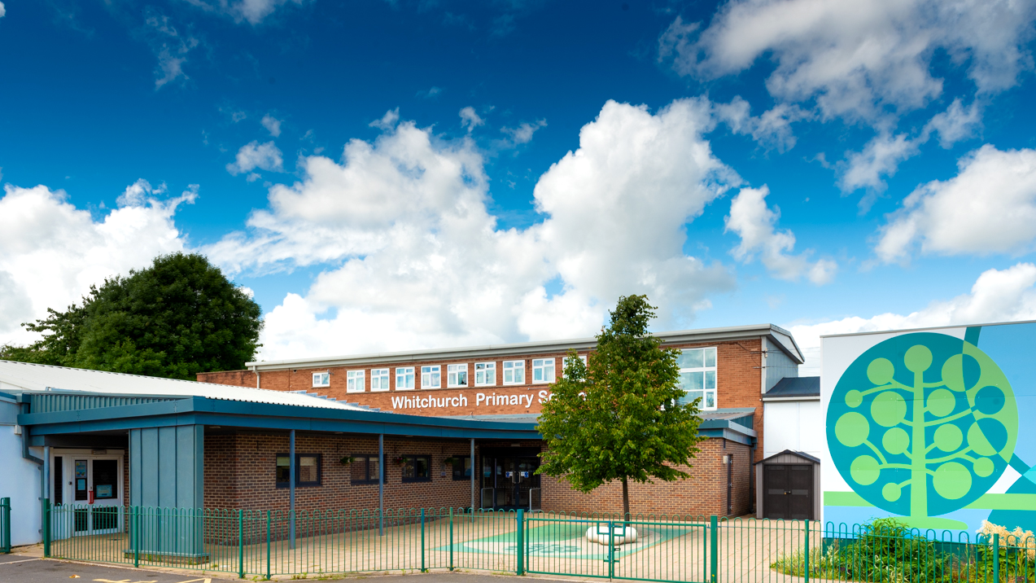

Whitchurch Primary School: Welcome to Year 2
Photo of school

Slide 2
Our Vision and Values

Slide 3


Notes:
N.J

Slide 4


Slide 5
Parent Meetings
November 2026 - Parent Consultations (Online)
February 2027 - Parent Consultations (Face to face)
July 2027 - Curriculum Celebration event

Slide 6
Attendance and Punctuality

Slide 7
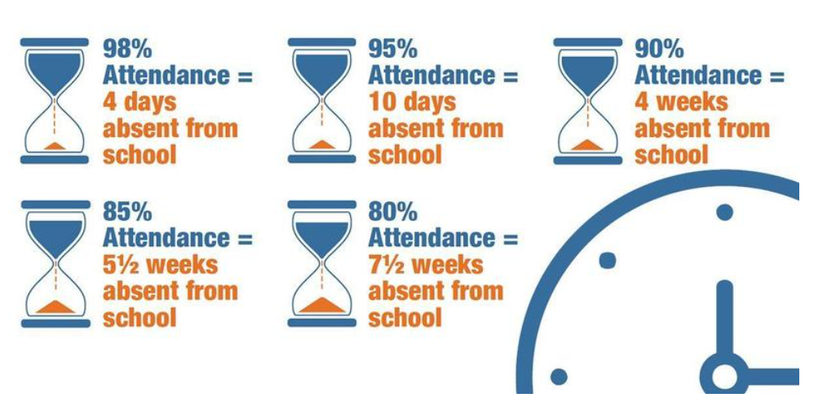
Reading
Attendance
Attendance Target: 96% Currently: 95%

Slide 8
Punctuality
Teaching at Whitchurch Primary School starts at 8.55am.
Please make every effort to ensure that your child arrives on time, to minimise disruption for the pupil, the rest of the class and the teacher: late arrivals may miss the important teaching points at the start of the lesson.
Minutes late | Days lost in school
5 minutes | 3 days
10 minutes | 6.5 days
15 minutes | 10 days
20 minutes | 13 days
30 minutes | 19 days
Any child who arrives after 8.55am, including those using the Foundation Phase entrance, will need to be signed in electronically at the main Reception office.

Slide 9
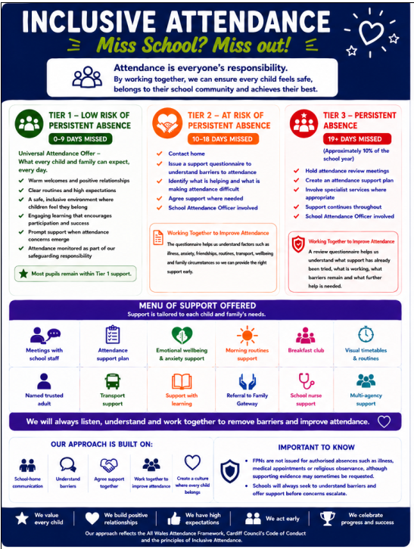
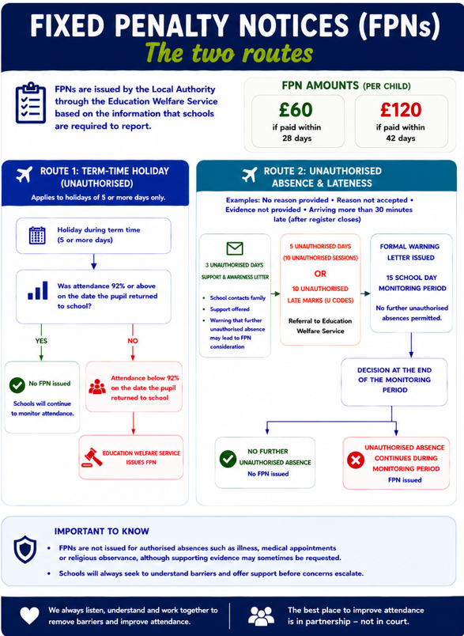
Attendance

Slide 10
Reading

Slide 11

Reading Books
We will be reading with your child in school and assessing their current reading levels. We will be sending books home for them to practice their skills with you and develop a love of reading.
We will send information / words to practise at home and we appreciate your support in practising these regularly at home.
Reading books will be changed on a Monday and Wednesday but please send your child with their book bag everyday.

Slide 12
Power of Reading
Children that read 20 minutes every day or more can learn upward of two million words annually.
Regular reading has been shown to lower stress levels by as much as 68%.
80% of children have increases in specific areas of the brain when they’re read to daily.
Children that read for five minutes every day take in 282,000 new words every year.

Slide 13
A Day in Year 2

Slide 14
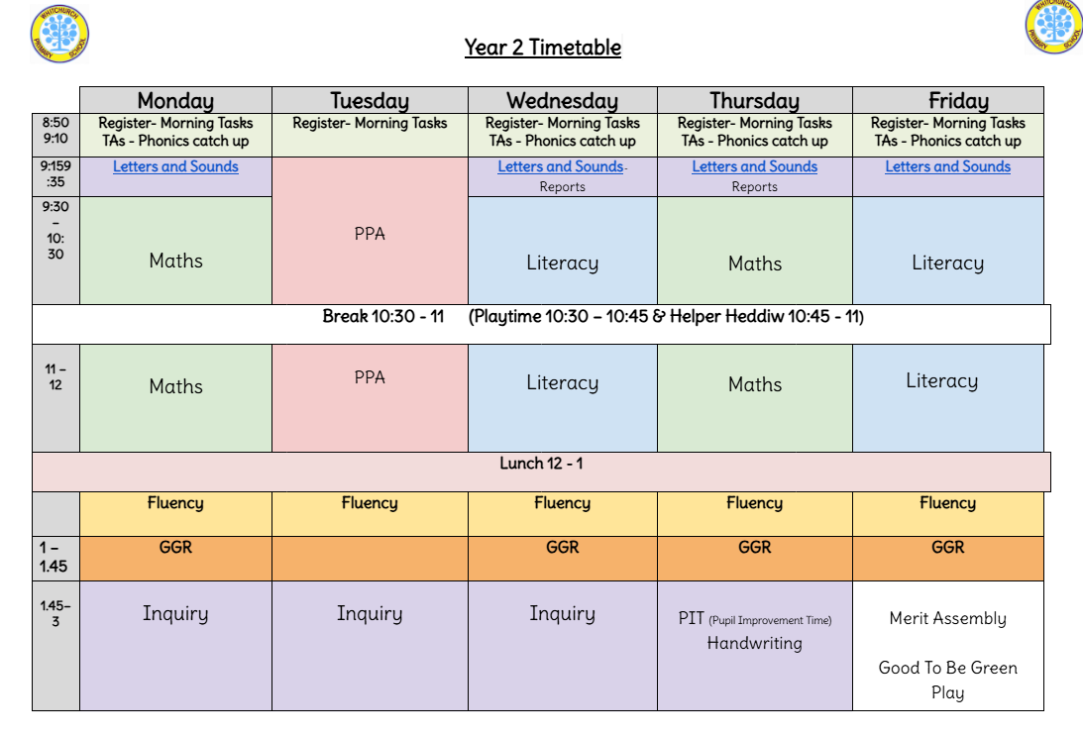
Notes:
N.J

Slide 15
Useful Information about Year 2

Slide 16

Drinks Bottles and Snacks
We are a Healthy School and promote the children having continuous access to clean water.
Please ensure your child brings in a labelled drinks bottle daily. This is in addition to any water bottles you wish to provide for lunchtime. The children will have continual access to drinking water throughout the day.
Notes:
SL

Slide 17


Snack Time
Snack is available throughout the morning and pupils are encouraged to independently choose when to eat their snack / drink.
As a school we support small businesses and provide your child with a healthy snack each day from the local green grocers.
We would appreciate a contribution of £1 per week to cover the cost of this. This can be paid via the parent pay app for each half term. Please see the office if you need your payment information.

Slide 18

P.E.
Year 2 PE day will be on a Thursday.
Please send your child to school wearing their PE kit (black leggings, joggers, shorts; white t-shirt and trainers) on class their PE day. They can wear their school uniform jumpers/cardigans on top as normal.
Pupils will need to bring their PE kit to change into if attending after school sports clubs.

Slide 19
Extra Help
Free School Meals; additional funding. If you receive the following, your family can apply for Free School Meals funding:
Income Related Employment Support Allowance
Income Support
Income Based Jobseeker's Allowance
Guarantee Element of State Pension Credit
Child Tax Credit with an income less than £16,190 or
Universal Credit if the net household earnings is less than £7400.

Slide 20
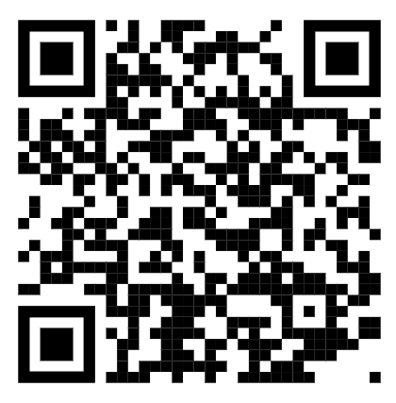
Why apply?
The school will get a small amount of funding per child- this can be used to support the children with resources in school, additional adult help if needed and contributions and payment of after school clubs, music lessons, trips and residential trips. This will ensure that all our pupils get the best possible experiences at Whitchurch.
To apply visit this link on Cardiff Council’s website:
https://www.cardiffcouncilforms.co.uk/article/1684/

Slide 21
Allergies
Should your child have any food allergies and receive a school meal:
Parents/carers must consult with their health professional in regard to their child’s specific dietary need.
Parents/carers or their chosen health professional should contact Education Catering at educationcatering@cardiff.gov.uk to outline the specific dietary requirement.
A member of the Education Catering Operations Team will liaise with the prates/carers/health professional to develop where possible a menu and environment that addresses the pupil’s specific dietary needs.
The agreed menu will then be implemented in school
Please note that when considering the safe provision of a meal to a child with a severe allergy Cardiff Education Catering will follow the recommendation of the health professional. Additionally, they are unable to provide a therapeutic diet to pupils of primary school age without the guidance of a health professional. Where a pupil has a complex need, Cardiff Education Catering are happy to work with parents/carers, schools and pupils to develop a school meal solution.
Education Catering operates and maintains an allergen matrix, which lists all the 14 allergens listed under retained EU regulation 1169/2011 Food Information to Consumers that appear or may appear in dishes on their menu. This matrix is available upon request.

Slide 22
PTA
The PTA help organise events and activities for the children which raise money for the school.
Activities include: Colour Run, Discos, Fetes, Easter bonnets, Halloween pumpkin competitions.
However, we only have a small team of 5 people and would love more help so we can organise a better and bigger range of family events. Please let us know if you would be interested in joining the PTA.
Thank you in advance!

Slide 23
Home Communication

Slide 24

Homelinks
General school information can be found on the website.
https://whitchurchprm.web11.juniperwebsites.co.uk/
Weekly updates will be sent initially through Parentmail but we will moving to Arbor in the near future.
Celebrations and achievements will be visible on Facebook.
The children will be bringing home letters containing details of how to access our online learning programme- Numbots.

Slide 25

Arbor Parent App
We are launching the Parent App for Arbor. This will give all parents access to key information such as; attendance, your child’s contact details and allergy and medical information. Consent for trips and photographs will also be able to be accessed.
Please check this is accurate when it is launched and amend as necessary if incorrect. Please also speak to teachers if there are any medical and allergy changes.
Moving forward all messages and emails are going to be through the app once fully launched.

Slide 26
Curriculum

Slide 27
Example Yearly Overview
Autumn Term
Spring Term
Summer Term
Language, Literacy and Communication
Mathematics and Numeracy
Health and Wellbeing
Humanities
Expressive Arts
Science and Technology
Notes:
KD

Slide 28
Literacy, Language & Communication:
Postcard
Setting description
Diary
Newspaper
Welsh: Language patterns.. Ble rwyt ti'n byw?, Sut mae tywydd heddiw? Sawl sy’ yma?
Key concepts:
belonging, community, change- human processes (transport), chronology, place, care, viewpoints
Numeracy:
Place Value
Statistics
Geometry - Position & Direction
Addition & Subtraction within 100
Humanities:
-Pupils will begin to explore wider passages of time and be introduced to time periods. They will begin to explore change in history with a focus on how transport has changed in Wales over time.
-Pupils will explore the local area and undertake traffic surveys and question the local community and family members about traffic issues.
-Pupils will look at local maps in the area and begin to draw their own maps and keys for routes in the local area to the school.
Year 2 Autumn Term: Time Traveller
Transport Affects Communities
Expressive Arts:
Digital film
PE: Rubicon Dance/Real PE
Science & Technology:
Materials and their uses Mechanisms; design and make their own car
Digital skills: Show me the code
Let’s Create
Data, data everywhere
Health & Wellbeing:
H&WB; Belonging, decision-making
Jigsaw; - Relationships and Identity
- Empowerment, safety and respect
Other Experiences: Trip to Brecon Mountain Railway, Traffic survey in the local area, Grandparents/Neighbours day, Christmas concert
Notes:
KD

Slide 29
Literacy, Language & Communication:
Poetry
Narrative
Welsh: language patterns.. Beth wyt ti’n [verb]? Beth wyt ti eisiau [verb]?
Key concepts:
Expressive Arts: Pattern, shape, texture
Humanities: Place, Space, Change
H&WB: Care, decision making, risks
Numeracy:
Multiplication & Division
Fractions
Geometry - Position & Direction
Geometry - Properties of Shape
Expressive Arts:
Pupils will explore and compare different habitats around the world, pupils will also explore patterns in nature - weather, seasons, animals.
They will explore and experiment with a range of techniques and processes from different artists, craft makers and musicians. They will compare the use of pattern of these wide range of artists and experiences and use them to create their own works of art, music and dance compositions.
The pupils will share and celebrate their work with parents and family members through an art gallery and dance/music showcase.
Year 2 Spring Term:
Wildly Creative
Patterns help us understand the world
Humanities:
-Landscapes
-Weather
-Physical and human features.
Science & Technology:
Textiles: joining materials
Digital skills: It’s good to talk
Working together
Health & Wellbeing:
PE: Rubicon Dance/Real PE
Jigsaw: Dreams & Goals
Healthy Me
Other Experiences: Trip to the National Museum Cardiff, Expressive Arts Showcase
Notes:
KD?

Slide 30
Literacy, Language & Communication:
Non-chronological report
Instruction writing
Narrative
Letter writing
Welsh: language patterns… Beth mae Sam yn [verb]? Oes [noun] gyda ti? Beth sydd gyda ti? ▪ Sawl [noun] sy’ gyda [Sam]? Oes [noun] gyda [Sam]? Faint ydy [noun]?
Key concepts:
Science: Energy, Forces,
DT: design, make, evaluate, mechanism
H&WB: Care, decision making, risks
Numeracy:
Measure - Length & height
Statistics
Measure - Weight & capacity
Measure - Time
Year 2 Summer Term:
Lights, Sound, Action!
Forces and energy impact our lives.
Humanities:
How forces are used to improve lives
Science and Technology:
-Pupils will explore the concepts of forces and energy through electricity, light, sound and magnetism. They will undertake a wide range of scientific enquiry to understand forces and energy in real life situations and how energy is transferred to make things move, speed up, change direction, light up or make sound.
-They will further explore energy transference through mechanisms and plan, design and make a moving pneumatic vehicle/toy.
Expressive Arts:
-Rubicon dance
Health & Wellbeing:
Jigsaw:
Relationships
Changing Me
PE: Rubicon Dance/Real PE
Other Experiences: Explorer Dome workshop, showcase pneumatic models to other progression steps.
Notes:
KD?

Slide 31

3 strands
Most are covered in Jigsaw.
E.g
Body parts
Personal hygiene
Human life cycle
Trusted adults
Notes:
NJ

Slide 32
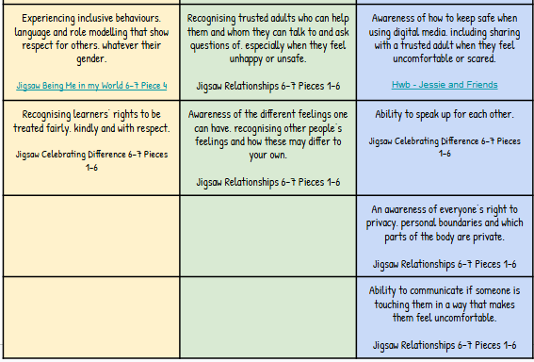
3 strands
Most are covered in Jigsaw.
E.g
Body parts
Personal hygiene
Human life cycle
Trusted adults
Notes:
NJ

