Slide 1
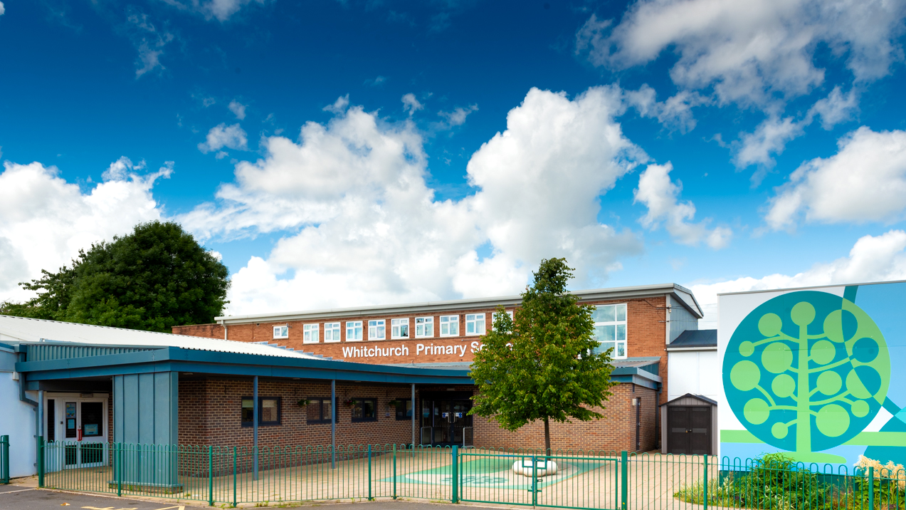

Whitchurch Primary School Welcome to Year 3
Photo of school

Slide 2
Our Vision and Values

Slide 3


Notes:
Whitchurch’s aim is to deliver the highest standard of education and care for all our pupils.
We aim for us all, as learners, to:
feel safe and valued as part of a caring community that celebrates success;
be independent thinkers / learners who are able to seek solutions creatively and co-operatively;
inspire an ‘enquiring’ mind and ask questions;
be confident enough to take risks in our learning;
experience and actively participate in a relevant, enjoyable curriculum that evolves to meet the needs of all;
be able to listen and articulate responses showing consideration to others.
be polite and courteous;
be proactive in our responsibilities towards the community, society, the environment and economy, linking ‘real life’ with our learning;
understand and respect diversity;
be aware of and recognise our own learning needs and be involved in planning future steps;
develop a sense of self esteem: be well balanced and healthy individuals.

Slide 4


Slide 5
Parent Meetings
November 2026 - Parent Consultations (Online)
February 2027 - Parent Consultations (Face to face)
July 2027 - Curriculum Celebration event

Slide 6
Attendance and Punctuality

Slide 7
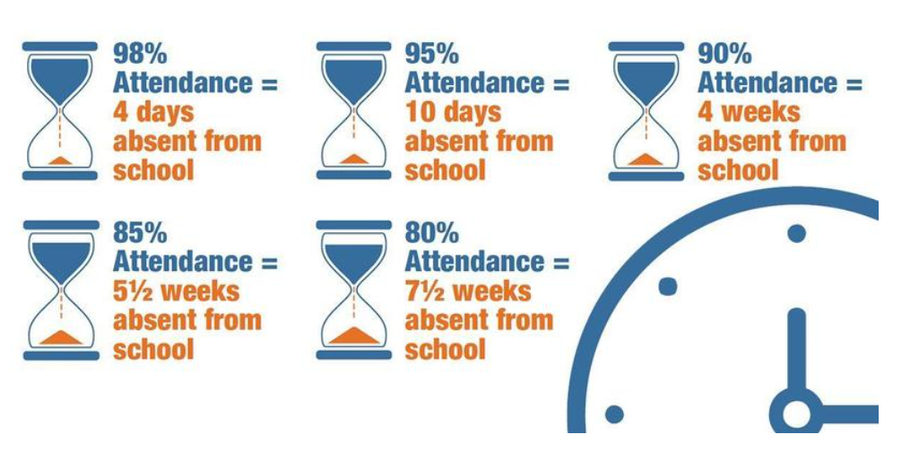
Reading
Attendance
Attendance Target: 96% Currently: 95%

Slide 8
Punctuality
Teaching at Whitchurch Primary School starts at 8.55am.
Please make every effort to ensure that your child arrives on time, to minimise disruption for the pupil, the rest of the class and the teacher: late arrivals may miss the important teaching points at the start of the lesson.
Minutes late | Days lost in school
5 minutes | 3 days
10 minutes | 6.5 days
15 minutes | 10 days
20 minutes | 13 days
30 minutes | 19 days
Any child who arrives after 8.55am, including those using the Foundation Phase entrance, will need to be signed in electronically at the main Reception office.

Slide 9

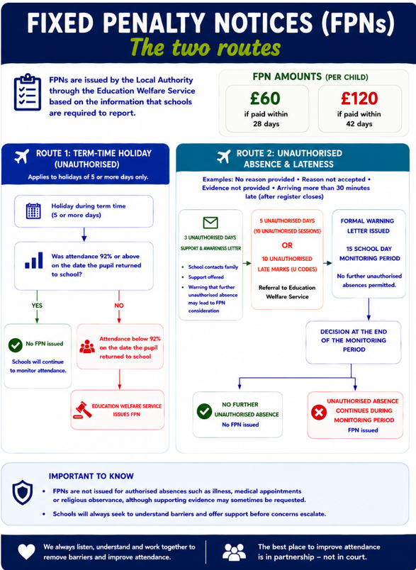
Attendance

Slide 10
Reading

Slide 11
Reading
Children from Year 3 up to Year 6 continue to have reading at the centre of all learning. Now that they can decode accurately and fluently, they build on from these strong foundation skills.
Children read independently, as a class and in all of their other foundation subjects (such as Geography, History, RE and Science).
Children have the opportunity for individual quiet reading every day, reading as a whole class, and being heard read by an adult in school every day, should they require the additional support.

Slide 12
Reading
At this age, it is still important to read to and listen to your child read daily. We need all children to foster a love of reading, whether this be novels, information texts, graphic novels or magazines.
Children need to bring their reading records into school each week. If they have read at least three times a week they will get a raffle ticket which gives them a chance to win a prize.

Slide 13



Whole Class Reading Texts for Year 3

Slide 14
Reading Books
Children are provided with opportunities to read independently and for pleasure daily in Year 3.
Therefore, your child will be expected to have a reading book in school every day. These can be borrowed from our book corner, a book banded book or their own book from home.
These books can be kept in their lockers at school or brought home if they wish to continue reading in their free time.

Slide 15
Power of Reading
Children that read 20 minutes every day or more can learn upward of two million words annually.
Regular reading has been shown to lower stress levels by as much as 68%.
80% of children have increases in specific areas of the brain when they’re read to daily.
Children that read for five minutes every day take in 282,000 new words every year.

Slide 16
Day in the life of Year 3

Slide 17
 | Monday | Tuesday | Wednesday | Thursday | Friday
8:50 9:10 | Morning Challenge
9:10 9:30 | Spelling | Spelling | Spelling | Spelling | Spelling
9:30 – 10: 30 | Literacy | Literacy | Literacy | Literacy | Literacy
Break
10.45 - 11 | Dyddiol Deg | Dyddiol Deg | Dyddiol Deg | Dyddiol Deg | Dyddiol Deg
11 – 12 | Maths | Maths | Maths | Maths | Maths
Lunch
1 –1.30 | Whole Class Reading | Whole Class Reading | PPA Jigsaw Music Welsh | Whole Class Reading | Whole Class Reading
1.30 - 2.15 | P.E Rotation | Inquiry |  | Inquiry | Inquiry Assembly
2:15 – 3.15
 |  | Handwriting/Fluency |  | Maths Fluency/Handwriting Singing Assembly
 | Handwriting/Fluency | Assembly
Notes:
Edit and add PE / G2BG and merit assembly

Slide 18
Useful Information about Year 3

Slide 19
Drinks Bottles and Snacks
We are a Healthy School and promote the children having continuous access to clean water.
Please ensure your child brings in a labelled drinks bottle. This is in addition to any water bottles you wish to provide for lunchtime. The children will have continual access to drinking water throughout the day.
Our Healthy Schools Monitors provide a fruit trolley service each playtime, if your child would like to use this, we ask for 20p per day.
If they would like to bring their own snack for playtimes, please ensure it is healthy (e.g. fruit, vegetables or cereal bars).
Notes:
SL

Slide 20
P.E.
Your child’s P.E. days is as follows:
Monday
Please send your child to school with their PE kit (black shorts/ leggings/ joggers, white t-shirt and trainers) on the PE day.

Slide 21
Extra Help
Free School Meals; additional funding. If you receive the following, your family can apply for Free School Meals funding:
Income Related Employment Support Allowance
Income Support
Income Based Jobseeker's Allowance
Guarantee Element of State Pension Credit
Child Tax Credit with an income less than £16,190 or
Universal Credit if the net household earnings is less than £7400.

Slide 22
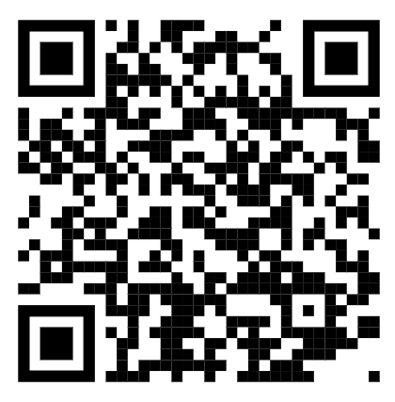
Why apply?
The school will get a small amount of funding per child- this can be used to support the children with resources in school, additional adult help if needed and contributions and payment of after school clubs, music lessons, trips and residential trips. This will ensure that all our pupils get the best possible experiences at Whitchurch.
To apply visit this link on Cardiff Council’s website:
https://www.cardiffcouncilforms.co.uk/article/1684/

Slide 23
Allergies
Should your child have any food allergies and receive a school meal:
Parents/carers must consult with their health professional in regard to their child’s specific dietary need.
Parents/carers or their chosen health professional should contact Education Catering at educationcatering@cardiff.gov.uk to outline the specific dietary requirement.
A member of the Education Catering Operations Team will liaise with the prates/carers/health professional to develop where possible a menu and environment that addresses the pupil’s specific dietary needs.
The agreed menu will then be implemented in school
Please note that when considering the safe provision of a meal to a child with a severe allergy Cardiff Education Catering will follow the recommendation of the health professional. Additionally, they are unable to provide a therapeutic diet to pupils of primary school age without the guidance of a health professional. Where a pupil has a complex need, Cardiff Education Catering are happy to work with parents/carers, schools and pupils to develop a school meal solution.
Education Catering operates and maintains an allergen matrix, which lists all the 14 allergens listed under retained EU regulation 1169/2011 Food Information to Consumers that appear or may appear in dishes on their menu. This matrix is available upon request.

Slide 24
PTA
The PTA help organise events and activities for the children which raise money for the school.
Activities include: Colour Run, Discos, Fetes, Easter bonnets, Halloween pumpkin competitions.
However, we only have a small team of 5 people and would love more help so we can organise a better and bigger range of family events. Please let us know if you would be interested in joining the PTA.
Thank you in advance!

Slide 25
Year 3 Outdoor Area
Our Year 3 outdoor area is situated under the canopy outside the Year 3 corridor.
A lot of time and effort has been spent to set up an engaging and inviting area for our Year 3’s.
Please ensure all siblings are kept out of the Year 3 area during the mornings and especially at the end of the day.
Diolch.

Slide 26
Home Communication

Slide 27

Homelinks
General school information can be found on the website.
https://whitchurchprm.web11.juniperwebsites.co.uk/
Weekly updates will be sent initially through Parentmail but we will moving to Arbor in the near future.
Celebrations and achievements will be visible on Facebook.

Slide 28
Homework
Spellings
We practise spellings regularly in class. Children complete a range of activities to consolidate their understanding of spelling patterns and are given opportunities to apply them in their writing.
Maths
Times Tables Rockstars - focusing on multiplication fluency. Children have a log in for this.
Reading
Reading books will be sent home, we encourage pupils to change their book when they have finished!

Slide 29

Arbor Parent App
We are launching the Parent App for Arbor. This will give all parents access to key information such as; attendance, your child’s contact details and allergy and medical information. Consent for trips and photographs will also be able to be accessed.
Please check this is accurate when it is launched and amend as necessary if incorrect. Please also speak to teachers if there are any medical and allergy changes.
Moving forward all messages and emails are going to be through the app once fully launched.

Slide 30
Curriculum

Slide 31






Curriculum Design: Our Challenge Curriculum
Why? Learning to learn in a transforming world.
Statements of What Matters: knowledge, skills and experiences
Cross curricular skills
Concepts
Inquiry based learning
Integral skills
Planning for
learning
Culture for
learning
Pedagogy
Progression
Cross Cutting Themes: RSE, Human Rights, Diversity, Careers, Cynefin and Wider World
Work Together Play Together Succeed Together

Slide 32
Example Yearly Overview
Autumn Term
Spring Term
Summer Term
Language, Literacy and Communication
Mathematics and Numeracy
Health and Wellbeing
Humanities
Expressive Arts
Science and Technology

Slide 33
Key concepts:
Belonging, Community
Human Processes (settlements), Migration, Place, Chronology, Change, Rights, Equity, Viewpoints
Literacy, Language & Communication:
Setting Description
Instructional Writing
Persuasive Letter
Welsh: Ble wyt ti’n byw?
Numeracy:
Place value
3D Shapes
Addition and subtraction
Humanities:
Opinions, feelings and viewpoints can change over time.
Sequencing events using a timeline
Similarities and differences between Roman and Celt times
Causes and effects of events in Roman and Celt times and comparing to Whitchurch
Year 3 Autumn Term: Changing Communities
Expressive Arts:
Historical Drama
Playscripts
Mosaics
Science & Technology:
Designing using CAD software
Materials and structures
Using tools safely
Creating prototypes
Health & Wellbeing:
PE- Invasion games. Balance/ Coordination / Agility.
Jigsaw - Identity
Other Experiences: Trip to Caerleon - Roman Legion Museum and Amphitheatre
Visits from: Architecture Workshop to create a Roman villa.
Notes:
Edit

Slide 34
Key concepts:
Place, Care
Human Processes, Change
Numeracy:
Multiplication and division
Fractions
Statistics
Literacy, Language & Communication:
Poem
Explanation Text
Narrative
Year 3 Spring Term:
Our Precious Earth
Humanities:
How people and the natural world impact each other (pollution, deforestation)
Understanding why different locations are important
Expressive Arts:
Stop motion animation
Theme tunes and sound effects/voice overs
Science & Technology:
Living things and their habitats.
2D & 3D product design to use in animation.
Health & Wellbeing:
Making decisions and considering consequences
PE - Dance and gymnastics.
Jigsaw e.g. relationships
Other Experiences: Introduction to animation from industry professional,
Animation workshop with professional from BigFoot Studios to create collaborative film.
Notes:
Edit

Slide 35
Literacy Language & Communication:
Recount
Narrative
Key concepts:
Properties and materials, changes, design make and evaluate
Numeracy:
Weight and Capacity
Money to £10
Length and Perimeter
Time
Humanities:
Sustainability of packaging, materials and impact on environment (linking to previous inquiry)
Science and Technology:
Materials and their properties
Humanly constructed v natural materials
Reversible and irreversible changes
Designing and evaluating products
Year 3 Summer Term:
Materials and their properties
Health & Wellbeing:
PE - Outdoor skills. Athletics, rounders.
Jigsaw & RSE
Expressive Arts:
Digital media adverts
Other Experiences: Cook baked goods for local care home with an industry professional
Notes:
Edit

Slide 36
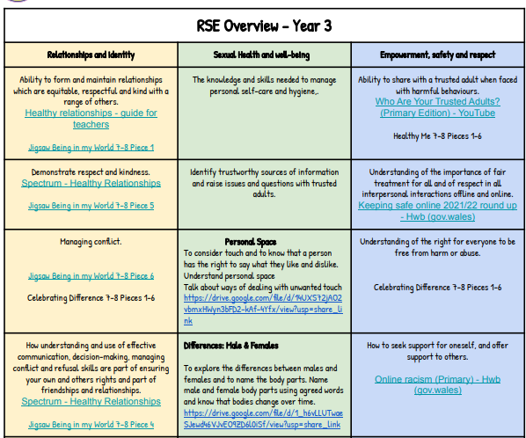
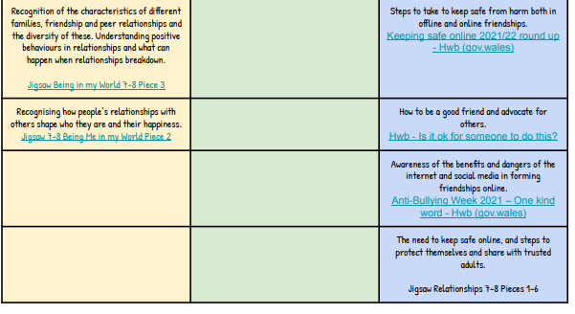
RSE Overview

