Slide 1
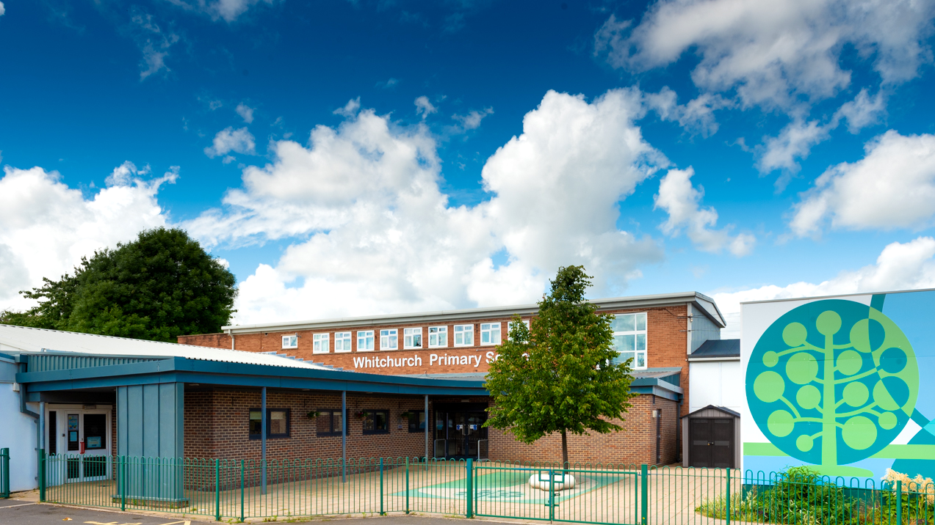

Whitchurch Primary School: Welcome to Year 5
Photo of school

Slide 2
Our Vision and Values

Slide 3



Slide 4


Slide 5
Parent Meetings
November 2026 - Parent Consultations (Online)
February 2027 - Parent Consultations (Face to face)
July 2027 - Curriculum Celebration event
Notes:
Sean

Slide 6
Attendance and Punctuality

Slide 7
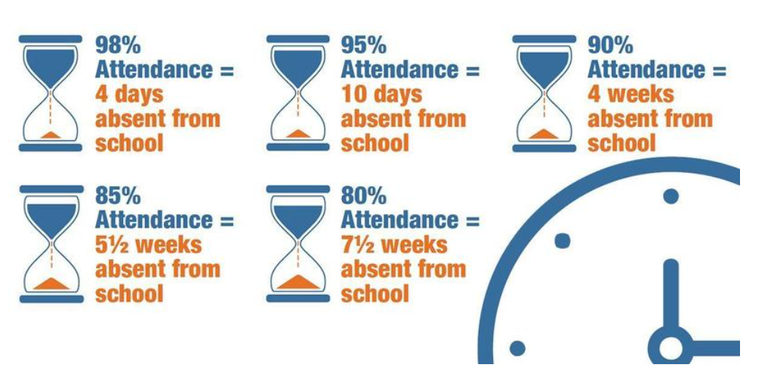
Attendance
Attendance Target: 96% Currently: 95%
Reading

Slide 8
Punctuality
Teaching at Whitchurch Primary School starts at 8.55am.
Please make every effort to ensure that your child arrives on time, to minimise disruption for the pupil, the rest of the class and the teacher: late arrivals may miss the important teaching points at the start of the lesson.
Minutes late | Days lost in school
5 minutes | 3 days
10 minutes | 6.5 days
15 minutes | 10 days
20 minutes | 13 days
30 minutes | 19 days
Any child who arrives after 8.55am, including those using the Foundation Phase entrance, will need to be signed in electronically at the main Reception office.

Slide 9

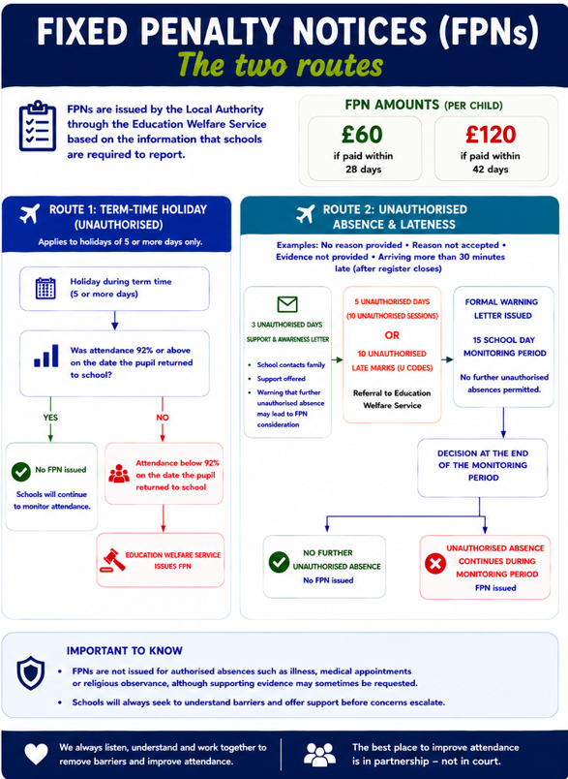
Attendance

Slide 10
Reading

Slide 11
Reading
Children from Year 4 up to Year 6 continue to have reading at the centre of all learning. Now that they can decode accurately and fluently, they build on from these strong foundation skills.
Children read independently, as a class and in all of their other foundation subjects (such as Geography, History, RE and Science).
Children have the opportunity for individual quiet reading every day, reading as a whole class, and being heard read by an adult in school every day, should they require the additional support.

Slide 12
Reading
At this age, it is still important to read to and listen to your child read daily. We need all children to foster a love of reading, whether this be novels, information texts, or magazines.
Children need to bring their reading records into school each week. If they have read at least three times a week they will get a raffle ticket which gives them a chance to win a prize.
Fridays - Reading records will be checked.

Slide 13
Reading Books
Children are provided with opportunities to read independently and for pleasure daily in Year 5.
Therefore, your child will be expected to have a reading book in school every day. These can be borrowed from our book corner, a book banded book or their own book from home.
These books can be kept in their lockers at school or brought home if they wish to continue reading in their free time.

Slide 14


Whole Class Reading Texts for Year 5

Slide 15
Power of Reading
Children that read 20 minutes every day or more can learn upward of two million words annually.
Regular reading has been shown to lower stress levels by as much as 68%.
80% of children have increases in specific areas of the brain when they’re read to daily.
Children that read for five minutes every day take in 282,000 new words every year.

Slide 16
Day in the life of Year 5

Slide 17
Year 5
Miss Lewis
Mr Davila
Mr Jones
Support: Mrs Jones and Mrs Weston
5EL
5LD
5SJ

Slide 18
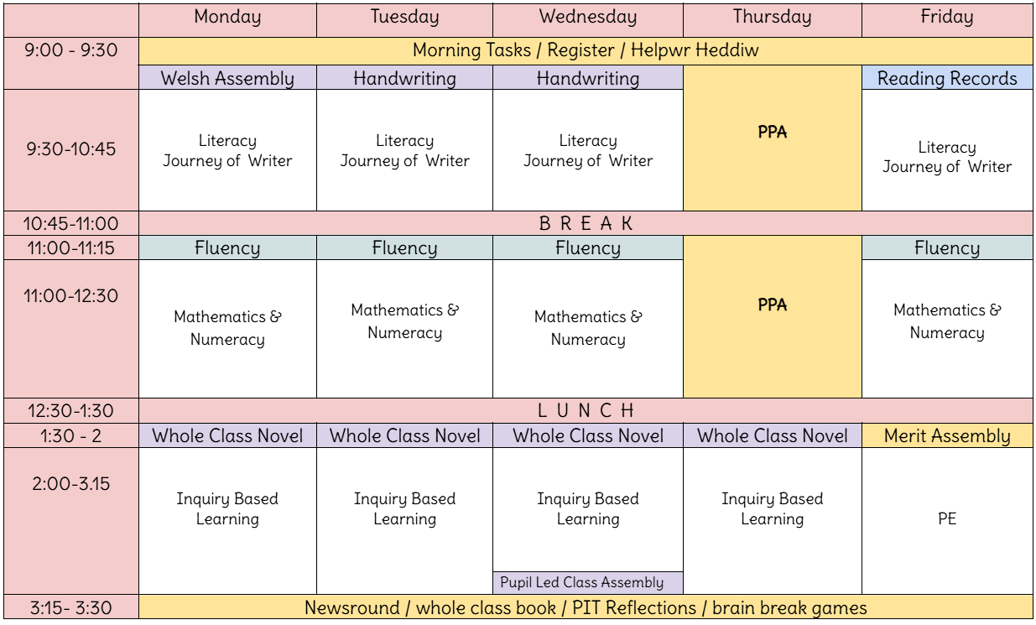
Notes:
Ella
Registration and morning activity (Literacy or Maths based)
Helpwr Heddiw (Welsh Oracy)
Literacy Lesson
Break time (10.30 – 10.45)
Maths Lesson
Lunchtime (12.30 – 1.30)
Reading Lesson
Inquiry Sessions
Assembly/Class Reader Storytime

Slide 19
Useful Information about Year 5

Slide 20
Drinks Bottles and Snacks
We are a Healthy School and promote the children having continuous access to clean water.
Please ensure your child brings in a labelled drinks bottle. This is in addition to any water bottles you wish to provide for lunchtime. The children will have continual access to drinking water throughout the day.
Our Healthy Schools Monitors provide a fruit trolley service each playtime, if your child would like to use this, we ask for 20p per day.
If they would like to bring their own snack for playtimes, please ensure it is healthy (e.g. fruit, vegetables or cereal bars).
Notes:
SL

Slide 21
P.E.
PE day for Year 5 will be a Friday.
Please ensure your child wears their PE kit to school for their PE day.
Kit includes: leggings/joggers/shorts/t-shirt and trainers)
Please could all jewellery be removed and long hair tied back please.

Slide 22
Extra Help
Free School Meals; additional funding. If you receive the following, your family can apply for Free School Meals funding:
Income Related Employment Support Allowance
Income Support
Income Based Jobseeker's Allowance
Guarantee Element of State Pension Credit
Child Tax Credit with an income less than £16,190 or
Universal Credit if the net household earnings is less than £7400.

Slide 23
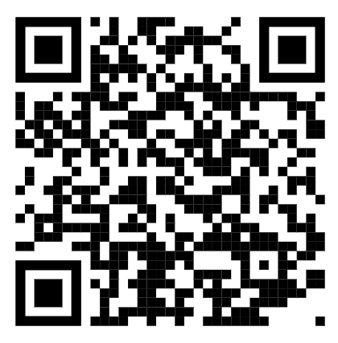
Why apply?
The school will get a small amount of funding per child- this can be used to support the children with resources in school, additional adult help if needed and contributions and payment of after school clubs, music lessons, trips and residential trips. This will ensure that all our pupils get the best possible experiences at Whitchurch.
To apply visit this link on Cardiff Council’s website:
https://www.cardiffcouncilforms.co.uk/article/1684/

Slide 24
Allergies
Should your child have any food allergies and receive a school meal:
Parents/carers must consult with their health professional in regard to their child’s specific dietary need.
Parents/carers or their chosen health professional should contact Education Catering at educationcatering@cardiff.gov.uk to outline the specific dietary requirement.
A member of the Education Catering Operations Team will liaise with the parents/carers/health professional to develop where possible a menu and environment that addresses the pupil’s specific dietary needs.
The agreed menu will then be implemented in school
Please note that when considering the safe provision of a meal to a child with a severe allergy Cardiff Education Catering will follow the recommendation of the health professional. Additionally, they are unable to provide a therapeutic diet to pupils of primary school age without the guidance of a health professional. Where a pupil has a complex need, Cardiff Education Catering are happy to work with parents/carers, schools and pupils to develop a school meal solution.
Education Catering operates and maintains an allergen matrix, which lists all the 14 allergens listed under retained EU regulation 1169/2011 Food Information to Consumers that appear or may appear in dishes on their menu. This matrix is available upon request.

Slide 25
Home Communication

Slide 26
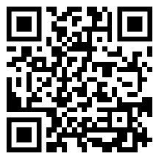

Homelinks
General school information can be found on the website:
https://whitchurchprm.web11.juniperwebsites.co.uk/
Weekly updates will be sent initially through Parentmail but we will moving to Arbor in the near future.
Celebrations and achievements will be visible on Facebook.

Slide 27

Arbor Parent App
We are launching the Parent App for Arbor. This will give all parents access to key information such as; attendance, your child’s contact details and allergy and medical information. Consent for trips and photographs will also be able to be accessed.
Please check this is accurate when it is launched and amend as necessary if incorrect. Please also speak to teachers if there are any medical and allergy changes.
Moving forward all messages and emails are going to be through the app once fully launched.

Slide 28
Homework

Slide 29
Homework
Spelling activities
We practise spellings regularly in class. Children complete a range of activities to consolidate their understanding of spelling patterns and are given opportunities to apply them in their writing. Spelling activities will be set on Google Classroom.
Maths
Times Tables Rockstars - focusing on multiplication fluency. Children have a login for this.
Reading
Reading books will be sent home, we encourage pupils to change their books on Fridays, when they have finished. Reading records will be checked every Friday.

Slide 30
Curriculum

Slide 31
Example Yearly Overview
Autumn Term
Spring Term
Summer Term
Language, Literacy and Communication
Mathematics and Numeracy
Health and Wellbeing
Humanities
Expressive Arts
Science and Technology
Notes:
Ella

Slide 32

Literacy, Language & Communication:
Non-chronological report
Narrative
Biography
Digital Advert
Welsh: time and events
Key concepts:
Power, equity, change.
Numeracy:
Place value to 1,000,000 and 2 decimal places
Addition and Subtraction
Multiplication and Division
Money
Year 5 Autumn Term Central Idea:
‘Children worldwide face a variety of challenges and opportunities.’
Digital skills:
Working Together
Put on Your Thinking Cap
Humanities (Inquiry Description):
Pupils will explore how rights of children changed from the Victorian era to now
Explore how children's’ rights differ around the world in the present day.
Taking Action:
They will raise awareness of the rights of the child.
The will organise a fundraising event to support children locally/globally.
Health & Wellbeing:
PE - ball games
Jigsaw
Science & Technology:
Science: Electricity
Technology: Electrical systems
Trips and Visits: Rhondda Heritage Park, Cadbury World, Bethesda
Notes:
Sean

Slide 33

Key concepts:
Identity, community, belonging
Literacy, Language & Communication:
Cultural story
Poetry
Explanation Text
Balanced Argument
Welsh: interests and hobbies
Numeracy:
Perimeter and area
Fractions
Decimals
Percentages
Year 5 Spring Term
Central Idea:
‘Culture is expressed in our local and global community through festivals and celebrations.’,’
Expressive Arts (Inquiry Description):
Pupils will explore diversity, cultures and festivals from around the world.
They will explore how literature, art, dance and music is linked to culture and identity.
Taking Action:
They will create their own music, art and dance pieces to showcase their emotions and identity.
Digital Skills:
It’s Good to Talk
Let’s Create
Science & Technology:
Science: states of matter.
Health & Wellbeing:
Jigsaw
PE – Invasion games and dance
Other Experiences: Eisteddfod celebrations, arts workshops, dance workshops, STEM workshops.
Notes:
Ella

Slide 34
Numeracy:
Perimeter, area and volume.
Measure – time
Measure – converting units
Geometry – shape, position and direction
Literacy, Language & Communication:
Narrative Writing
Formal Letter
Welsh: What’s the matter?
Body and illnesses.
Key concepts:
Survival, growth, classification, organisms
Science and Technology (Inquiry Description):
Pupils will explore and classify different plants and animals.
Pupils will describe the features of organisms and recognise how they allow them to live, grow and reproduce for survival in their environment
Taking Action:
The pupils will improve the local habitats and awareness.
Year 5 Summer Term Central Idea:
‘’Plants and animals lie and survive in diverse environments’
Digital skills:
Data, Data Everywhere
Show Me the Code
Health & Wellbeing:
Jigsaw
PE – striking and fielding.
Science and Technology:
Science – habitats, adaptation, classification and biodiversity
Technology - pulley system
Other Experiences: STEM week activities, Zoo Lab

Slide 35


