Slide 1
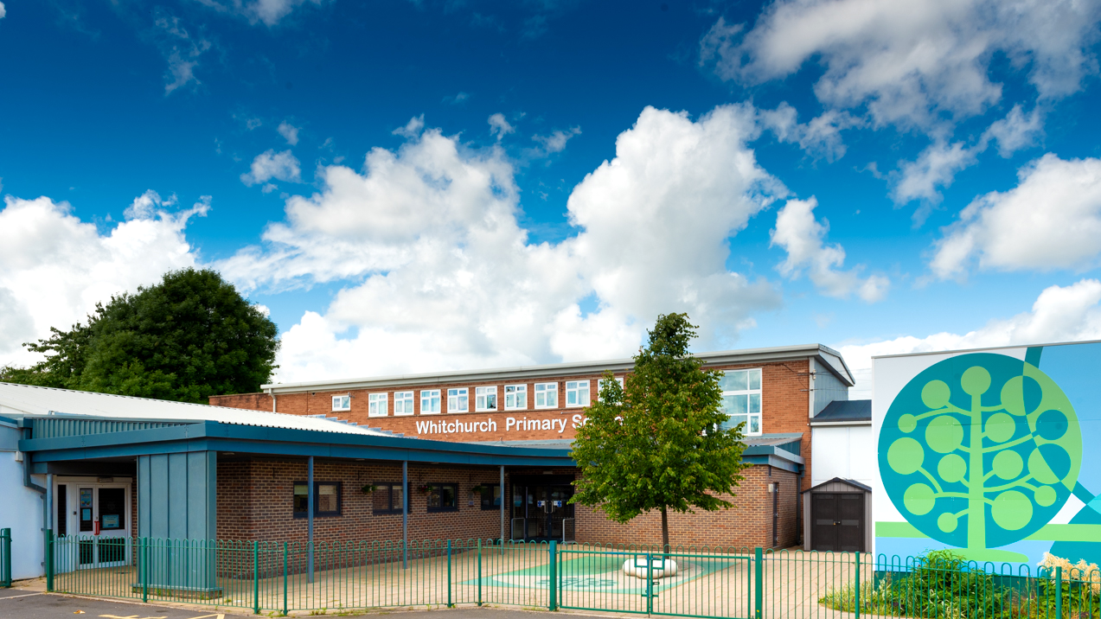

Whitchurch Primary School Welcome to Year 6
Photo of school

Slide 2
Our Vision and Values

Slide 3


Notes:
Whitchurch’s aim is to deliver the highest standard of education and care for all our pupils.
We aim for us all, as learners, to:
feel safe and valued as part of a caring community that celebrates success;
be independent thinkers / learners who are able to seek solutions creatively and co-operatively;
inspire an ‘enquiring’ mind and ask questions;
be confident enough to take risks in our learning;
experience and actively participate in a relevant, enjoyable curriculum that evolves to meet the needs of all;
be able to listen and articulate responses showing consideration to others.
be polite and courteous;
be proactive in our responsibilities towards the community, society, the environment and economy, linking ‘real life’ with our learning;
understand and respect diversity;
be aware of and recognise our own learning needs and be involved in planning future steps;
develop a sense of self esteem: be well balanced and healthy individuals.

Slide 4


Slide 5
Parent Meetings
October 2026 - Parent Consultations (Online)
February 2027 - Parent Consultations (Face to face)
July 2027 - Curriculum Celebration event

Slide 6
Attendance and Punctuality

Slide 7
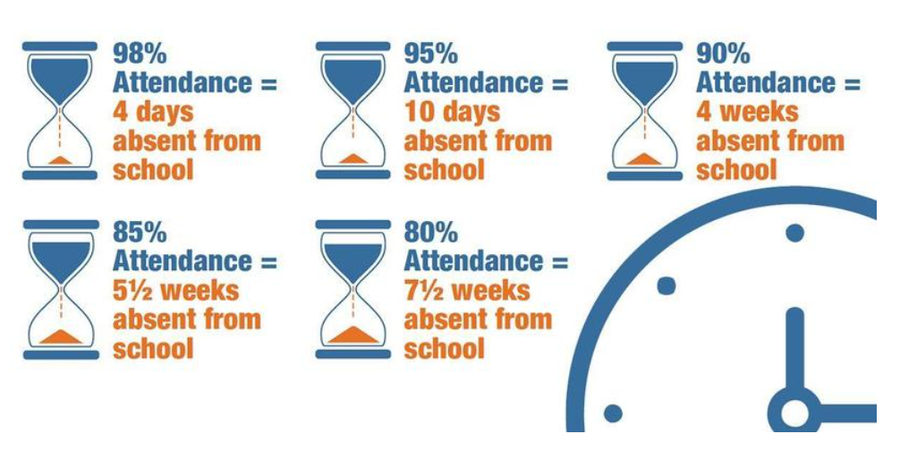
Attendance
Attendance Target: 96% Currently: 95%
Reading

Slide 8
Punctuality
Teaching at Whitchurch Primary School starts at 8.55am.
Please make every effort to ensure that your child arrives on time, to minimise disruption for the pupil, the rest of the class and the teacher: late arrivals may miss the important teaching points at the start of the lesson.
Minutes late | Days lost in school
5 minutes | 3 days
10 minutes | 6.5 days
15 minutes | 10 days
20 minutes | 13 days
30 minutes | 19 days
Any child who arrives after 8.55am, including those using the Foundation Phase entrance, will need to be signed in electronically at the main Reception office.

Slide 9

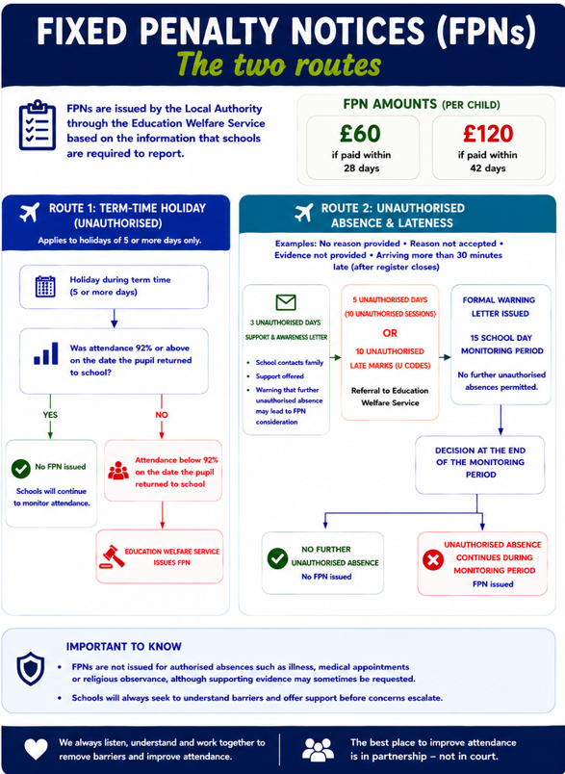
Attendance

Slide 10
Reading

Slide 11
Reading
Children from Year 4 up to Year 6 continue to have reading at the centre of all learning. Now that they can decode accurately and fluently, they build on from these strong foundation skills.
Children read independently, as a class and in all of their other foundation subjects (such as Geography, History, RE and Science).
Children have the opportunity for individual quiet reading every day, reading as a whole class, and being heard read by an adult in school every day, should they require the additional support.

Slide 12
Reading
At this age, it is still important to read to and listen to your child read daily. We need all children to foster a love of reading, whether this be novels, information texts, graphic novels or magazines.
Children need to bring their reading records into school each week. If they have read at least three times a week they will get a raffle ticket which gives them a chance to win a prize.
Fridays - Books can be changed
Reading records will be checked

Slide 13


Whole Class Reading Texts for Year 6

Slide 14
Reading Books
Children are provided with opportunities to read independently and for pleasure daily in Year 6.
Therefore, your child will be expected to have a reading book in school every day. These can be borrowed from our book corner, a book banded book or their own book from home.
These books can be kept in their lockers at school or brought home if they wish to continue reading in their free time.

Slide 15
Power of Reading
Children that read 20 minutes every day or more can learn upward of two million words annually.
Regular reading has been shown to lower stress levels by as much as 68%.
80% of children have increases in specific areas of the brain when they’re read to daily.
Children that read for five minutes every day take in 282,000 new words every year.

Slide 16
Day in the life of Year 6

Slide 17
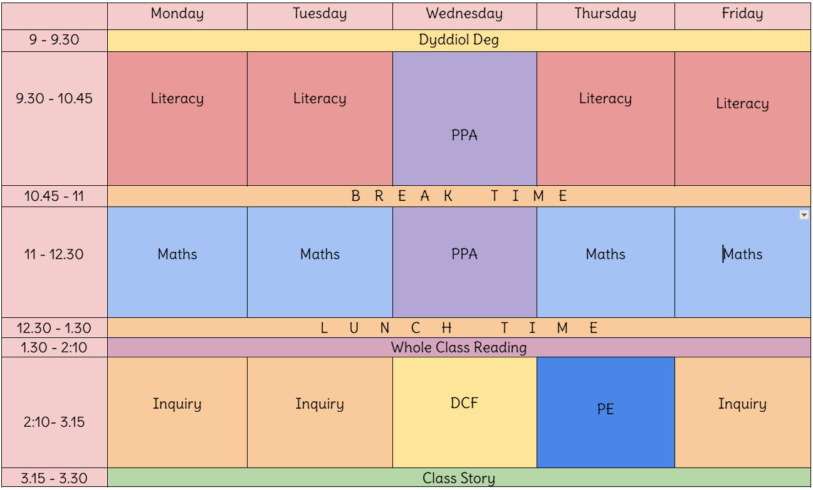

Slide 18
Useful Information about Year 6

Slide 19
Drinks Bottles and Snacks
We are a Healthy School and promote the children having continuous access to clean water.
Please ensure your child brings in a labelled drinks bottle. The children will have continual access to drinking water throughout the day.
Our Healthy Schools Monitors provide a fruit trolley service each playtime, if your child would like to use this, we ask for 20p per day.
If they would like to bring their own snack for playtimes, please ensure it is healthy (e.g. fruit, vegetables or cereal bars).
Notes:
SL

Slide 20
P.E.
PE day for Year 6 will be a Thursday.
Please ensure your child wears heir PE kit to school for their PE day.
Kit includes: leggings/joggers/shorts/t-shirt and trainers)
Please could all jewellery be removed and long hair tied back please.

Slide 21
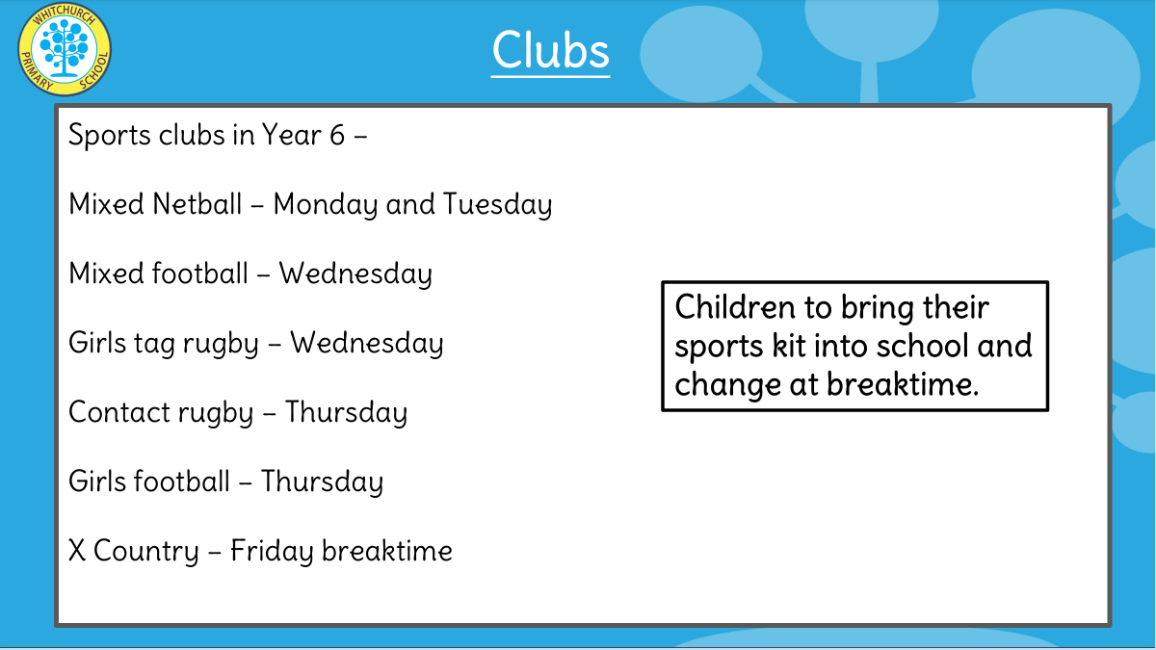
P.E.
Your child’s P.E. days is as follows:
Thursday
Please send your child to school with their PE kit (black shorts/ leggings/ joggers, white t-shirt and trainers) on the PE day.

Slide 22
Extra Help
Free School Meals; additional funding. If you receive the following, your family can apply for Free School Meals funding:
Income Related Employment Support Allowance
Income Support
Income Based Jobseeker's Allowance
Guarantee Element of State Pension Credit
Child Tax Credit with an income less than £16,190 or
Universal Credit if the net household earnings is less than £7400.

Slide 23
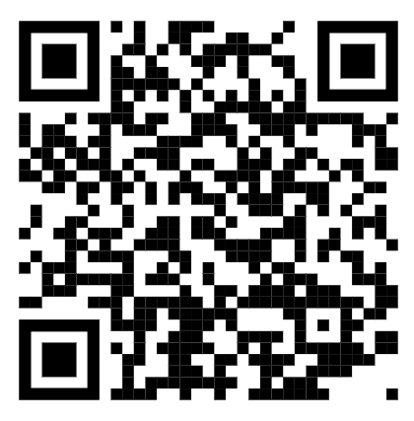
Why apply?
The school will get a small amount of funding per child- this can be used to support the children with resources in school, additional adult help if needed and contributions and payment of after school clubs, music lessons, trips and residential trips. This will ensure that all our pupils get the best possible experiences at Whitchurch.
To apply visit this link on Cardiff Council’s website:
https://www.cardiffcouncilforms.co.uk/article/1684/

Slide 24
Allergies
Should your child have any food allergies and receive a school meal:
Parents/carers must consult with their health professional in regard to their child’s specific dietary need.
Parents/carers or their chosen health professional should contact Education Catering at educationcatering@cardiff.gov.uk to outline the specific dietary requirement.
A member of the Education Catering Operations Team will liaise with the prates/carers/health professional to develop where possible a menu and environment that addresses the pupil’s specific dietary needs.
The agreed menu will then be implemented in school
Please note that when considering the safe provision of a meal to a child with a severe allergy Cardiff Education Catering will follow the recommendation of the health professional. Additionally, they are unable to provide a therapeutic diet to pupils of primary school age without the guidance of a health professional. Where a pupil has a complex need, Cardiff Education Catering are happy to work with parents/carers, schools and pupils to develop a school meal solution.
Education Catering operates and maintains an allergen matrix, which lists all the 14 allergens listed under retained EU regulation 1169/2011 Food Information to Consumers that appear or may appear in dishes on their menu. This matrix is available upon request.

Slide 25
Home Communication

Slide 26

Homelinks
General school information can be found on the website.
https://whitchurchprm.web11.juniperwebsites.co.uk/
Weekly updates will be sent initially through Parentmail but we will moving to Arbor in the near future.
Celebrations and achievements will be visible on Facebook.

Slide 27
Homework

Slide 28
Homework
Spelling activities
We practise spellings regularly in class. Children complete a range of activities to consolidate their understanding of spelling patterns and are given opportunities to apply them in their writing. Spelling activities will be set on Google Classroom.
Maths
Times Tables Rockstars - focusing on multiplication fluency. Children have a login for this.
Reading
Reading books will be sent home, we encourage pupils to change their books on Fridays, when they have finished.

Slide 29

Arbor Parent App
We are launching the Parent App for Arbor. This will give all parents access to key information such as; attendance, your child’s contact details and allergy and medical information. Consent for trips and photographs will also be able to be accessed.
Please check this is accurate when it is launched and amend as necessary if incorrect. Please also speak to teachers if there are any medical and allergy changes.
Moving forward all messages and emails are going to be through the app once fully launched.

Slide 30
Curriculum

Slide 31
Example Yearly Overview
Autumn Term
Spring Term
Summer Term
Language, Literacy and Communication
Mathematics and Numeracy
Health and Wellbeing
Humanities
Science and Technology
Expressive Arts

Slide 32
Literacy, Language & Communication:
Newspaper report
Instructional Writing
Diary Entry
Debate (Balanced Argument)
Poetry
Welsh: past tense (visit/activities)
Key concepts:
Power, conflict, peace, interpretation & rights.
Numeracy:
Place value to 1,000,000 and 3 decimal places
Four Operations
Fractions
Humanities (Inquiry Description):
Pupils will explore a variety of conflict within Wales and Globally.
They will discover how they were caused, their impact on communities and how they were resolved.
Evacuation, rationing and human rights.
Taking Action:
Pupils will create peace documentaries to share positive resolution.
Year 6 Autumn Term Central Idea:
‘Resolving Conflict can Lead to a Better Quality of Human Life’
Digital skills:
Show Me the Code and Data, Data Everywhere
Scratch
Health & Wellbeing:
PE- Invasion games and gymnastics.
Jigsaw - Links to Rights Respecting Schools.
Science & Technology:
Science: Links to rationing. Healthy balanced diet and food groups.
Technology: Cooking
Trips and Visits: Cardiff Castle

Slide 33
Literacy, Language & Communication:
Explanation text
Narrative
Welsh: weather (past, present, future)
Key concepts:
Place, change, causation, sustainability.
Numeracy:
Decimals
Percentages
Ratio
Statistics
Inquiry description:
Pupils will investigate forces and energy transfer, especially those linked to sound, light and renewable energy sources.
They will explore the impact of Global Warming and natural disasters and will design and make an eco village.
Year 6 Spring Term Central Idea:
‘Communities have a responsibility to access, share and protect resources.
Digital Skills:
Put on your Thinking Cap and Working Together
Health & Wellbeing:
Making decisions and considering consequences
PE – Hockey and Dance
Science & Technology:
Energy – light, sound, renewable energy.
Other Experiences: Visits from Welsh Water, One Planet Cardiff, visits from renewable energy company.

Slide 34
Literacy, Language & Communication:
Playscripts
Formal letters
Welsh: further past tense and opinions.
Key concepts:
Relationships, interpretations, audience, performance.
Numeracy:
Perimeter, area and volume.
Measure – time
Measure – converting units
Geometry – shape, position and direction
Year 6 Summer Term Central Idea:
‘Media has the power to influence thinking and behaviour.’
Digital skills:
It’s Good to Talk and Let’s Create
Inquiry description:
Pupils will explore the use of drama, media and theatre to show key issues, relationships between characters and how drama techniques can be used to convey emotions and feelings. Pupils will design and make stage props and perform a show to a large audience.
Health & Wellbeing:
Jigsaw
PE – striking and fielding.
Science and Technology:
Science – healthy body and body process
Technology - structures
Other Experiences: End of year show (production), residential trip to Llangrannog, visit to Llanishen reservoir.
Notes:
SL

Slide 35


